Slide 1
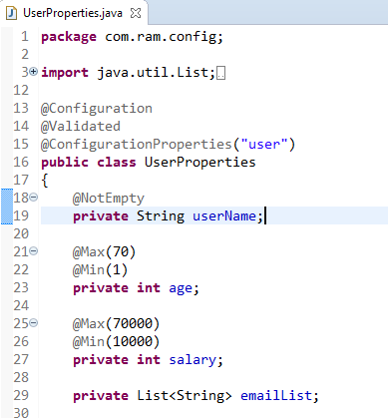
Spring Boot @ConfigurationProperties Property Validation
The @ConfigurationProperties support JSR-303 bean validation – javax.validation

